Slide 1
MANAGING YOUR ONLINE PRESENCE

Slide 2
Is it legal for your employer to look you up?

Slide 3
Is it legal for a potential employer to look you up?
YES! But…
http://www.businessreviewcanada.ca/marketing/772/Social-Media-in-the-Workplace:-Key-Lessons-for-Business-Professionals

Slide 4
Legal Issues: Recruitment
Employers may use social media tools to attract and screen potential candidates as long as no decisions are made that rely on information linked directly or indirectly to prohibited grounds of discrimination.
If an employer wishes to consider information outside a candidate’s resumé, it should ensure that information is rationally connected to the requirements of the job in question. (ex. On-line portfolio vs Facebook page)
However, given the amount of personal information publicly shared on social networking sites, and the extent of some individuals’ online presence, this can be a difficult task.

Slide 5
Legal Issues: Recruitment
Some Examples:
If a recruiter inadvertently mentions that candidates were searched online, an employer might face a difficult human rights case if that unsuccessful candidate’s online presence revealed him or her to be associated with a protected group (eg. LGBT).
Similarly, an employer screening candidates’ social networking presence for evidence of “good character” or “judgment” may face liability even if the information discovered only indirectly links an individual to a prohibited ground. A stated interest in reggae music, for example, may give rise to a presumption of ethnicity, just as certain extracurricular activities or associations may give rise to a presumption of family status, religion, disability, and so on.

Slide 6
Legal Issues: Access & Monitoring
Employer Access
Some businesses have reportedly taken the extraordinary step of asking job candidates, and even current employees, to disclose their social networking login credentials. Although this is not illegal per se, as a best practice such a request should never be made.
Not only will an employer likely discover information linked to prohibited grounds, it may also be in violation of privacy laws by viewing information about third parties (i.e. the employee’s “friends”) who consented to share information only with a particular individual, not his or her employer.
Monitoring Activities
Employers may monitor their employees’ internet and social media use at work, provided that this practice is clearly communicated to employees in a written policy, and the policy is consistently enforced.

Slide 7
Legal Issues: Discipline & Discharge
Provided that employees are aware of the reasonable internet use policy and the policy is consistently enforced, employers may discipline employees up to and including dismissal for inappropriately using social media on company time.
The more challenging and practical problem, however, concerns an employee’s misuse of social media away from work. It is not uncommon, for example, for employees to vent about their work experiences on their personal social media pages. In these situations, to be disciplinable, the employee’s misconduct must harm the employer’s reputation and/or significantly impair the employment relationship.
Anything an employee says online about the employer or organization that is defamatory or libelous is potentially grounds for dismissal.

Slide 8
The Don’ts of Your Online Presence...

Slide 9
The DON’T’s of Your Online Presence
DON’T…
Don’t badmouth your current, previous or future employer online.
Don’t mention your job search if you are still employed and haven’t yet informed your supervisor
Don’t forget others can see your online friends, therefore a friends’ pictures and profiles may influence an employer’s impression of you.
Don’t include any links on your resume or online portfolio which may include content that is not appropriate for a business audience.
Don’t miss out by having no online presence at all. A lack of information can be detrimental as someone with the same name can be mistaken to be you.
http://careercenter.depaul.edu/networking/onlinepresence.aspx

Slide 10
The Do’s of Your Online Presence...

Slide 11
The Do’s of Your Online Presence - Minimize!
DO…
Google yourself - clean up if necessary (remove images, hasty comments, etc.)
Use privacy settings and note which content can be viewed publicly
Be aware of how others are representing you online. Monitor friends’ pictures, tags and other content.
Use neutral photographs on social networking sites that don’t show detail into your private life.
Be careful what you ‘like’ and what associations you are linked with
Be careful what you write about in blog posts or on twitter
http://careercenter.depaul.edu/networking/onlinepresence.aspx

Slide 12
The Do’s of Your Online Presence - Maximize!
DO…
Research social networking sites to decide which offer the image, privacy controls, etc that will work best for your professional image.
Set up a LinkedIn profile and use it to reflect your professional life
Consider creating professional accounts with various social media; twitter, instagram, etc.
Consider creating a professional website, online portfolio, etc.
Update your professional profiles regularly, up-to-date information is part of a professional presentation
http://careercenter.depaul.edu/networking/onlinepresence.aspx

Slide 13
Consider Creating a LinkedIN Profile… Why LinkedIN?
Much more than just an on-line profile - It’s an exceptional modern networking tool!
Use it to connect to and build your network
Make and receive introductions, recommendations and testimonials
Research & Follow your industry and network: companies, people, events, trends and overall landscape
Participate in professional conversations
Enhance the growth of your own organization
Seek and be sought for professional opportunities
Present yourself professionally online

Slide 14
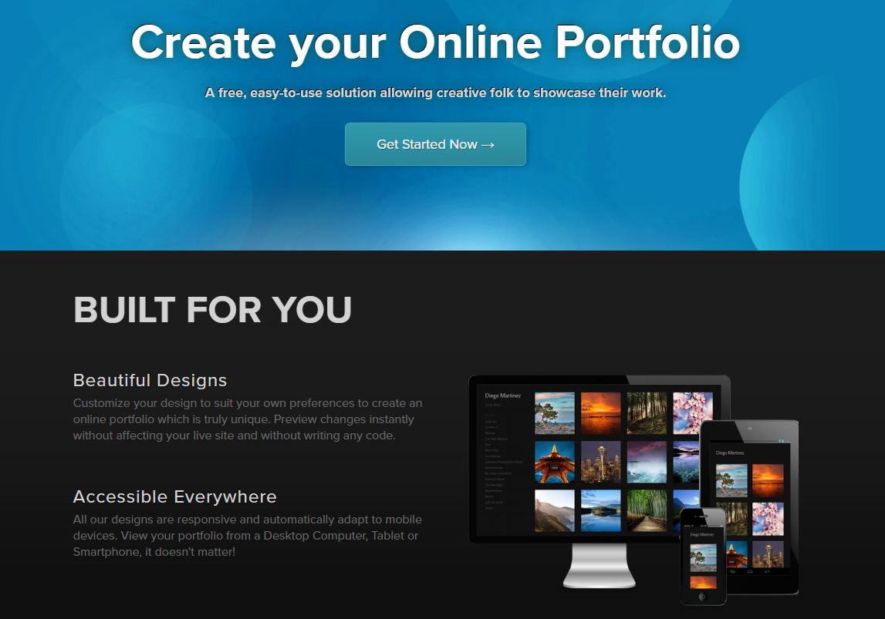
Consider Creating a
Professional Website / Online Portfolio
Wix.com
Squarespace.com
Crevado.com

Slide 15
https://sites.google.com/view/portfolio-temp/home

Slide 16

Consider Creating
Professional Social Media Accounts
But the same rule still apply...

Slide 17
Tips for Facebook
Use status updates moderately and effectively - who is your audience and what do they need to know?
Don’t spam; avoid sending out “mass” invitations or recommendations
Read Facebook’s privacy settings carefully and make sure your profile presents only what you want others to see. These settings change frequently and it is best to check periodically to see if they are what you want them to be for your profile.
Use Facebook to gain new contacts. Use key words within the search box to find groups relevant to your career interests.
Create separate friends lists for your group of contacts. This can be incredibly useful as it can allow you to filter which friends can see your profile information, photos and status updates; as well as allow you to easily split your personal friends from your professional friends when looking at your newsfeed or main page.

Slide 18
Tips for Twitter
Market yourself in your bio
Customize your background to showcase your skills and creativity
Have a link to your online resume (tools like VisualCV can help)
Follow industry experts in your industry on Twitter (tools like Twellow.com can help)
Use TwitterJobSearch to find positions
Decide if your account is personal or professional and link accordingly
Once you are working, make sure you don’t tweet inappropriately about your employer

Slide 19
Final Tips for Building your
Online Professional Presence
Updating your accounts regularly with relevant information
Be consistent through all your social media separating the personal from the professional
Introducing yourself when adding a new friend or for a connection; don’t send a generic link, explain who you are and why you would like to connect with them
Join groups that relate to your career area, follow people in your industry
View the connections of your connections. People you know maybe connected to people in your career area; if so, ask your connections for an introduction
Don’t be ashamed to say you’re looking for work. People have been successful finding work by using social media by letting others know they are unemployed.
Ask for advice. Not for a job; ask about potential opportunities, recruitment practices, suggested connections or directions for further investigation
Many organizations are using Facebook and Twitter to share information about their operations, so don’t forget to use these venues to find company information too.

